Slide 1
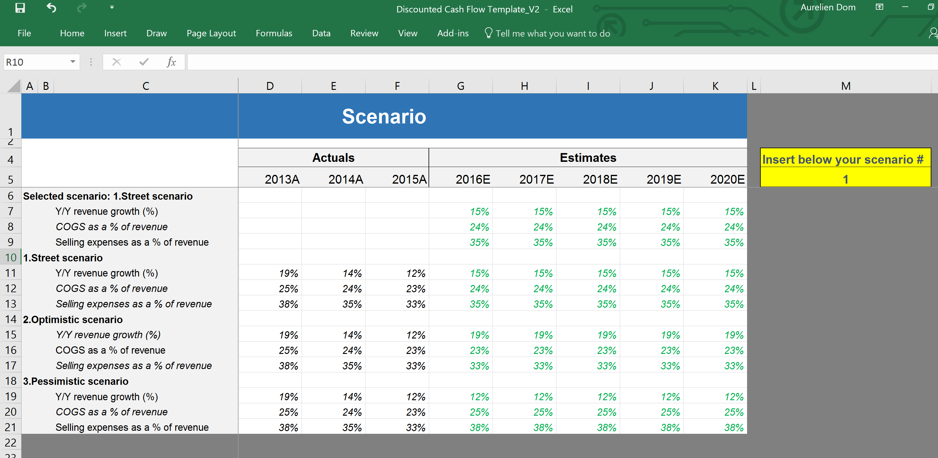
Discounted Cash Flow Model Example 1 - Tutorial
Confidential
Created by former JP Morgan Investment Bankers, and McKinsey & Deloitte Consultants

Slide 2
Introduction
A Discounted Cash Flow (DCF) Analysis is a valuation method used to estimate the attractiveness of an investment opportunity. DCF analysis uses future free cash flow projections and discounts them to arrive at a present value estimate, which is used to evaluate the potential for investment.
See below the formula to estimate a Company estimated Intrinsic Value:
Company estimated Intrinsic Value
Net Present Value of Unlevered Free Cash Flow
Net Present Value of Terminal Value
=
+
Then you can decide if it is a good investment by:
Comparing the Company estimated Intrinsic Value and the Market Value
Calculating the Internal Rate of Return
Calculating the Target Price Upside

Slide 3
Building blocks
Blocks from the 3 statement financial model
New Building Blocks to be created
Actuals
Estimates
Assumption
Income statement
Balance sheet
Cash flow statement
Working capital
Depreciations
Debt & Interest
DCF
Dashboard

Slide 4
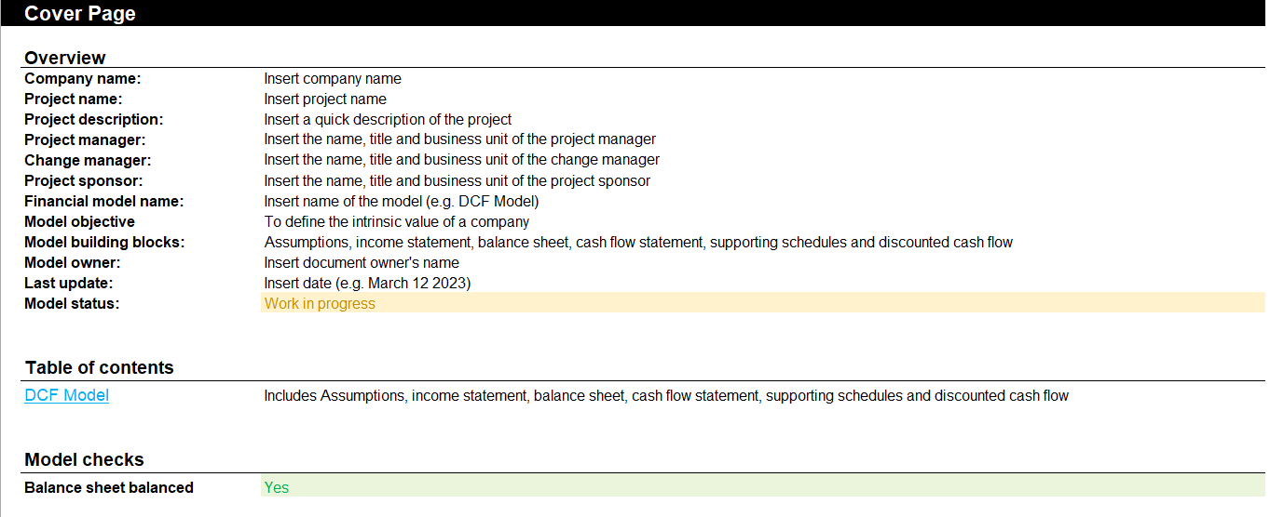
Step 1 - Open the document “Discounted Cash Flow Model” and fill in the cover page

Slide 5
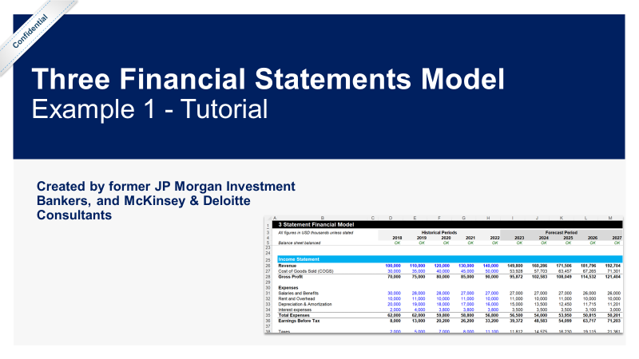
Step 2 - Apply the same steps described in the documents “1b. Three Financial Statements Model - Tutorial”
The Three Financial Statements Model is often used as the foundations of most models. In other words, to create a DCF Model, you need to first create a Three Financial Statements Model

Slide 6
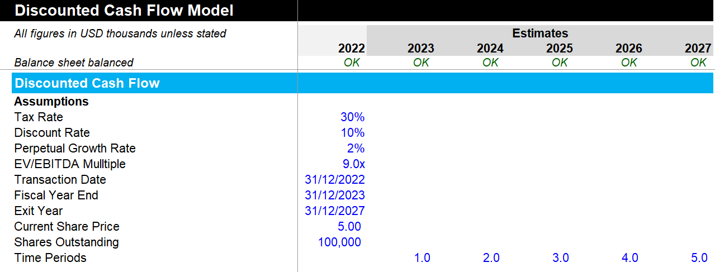
Step 3 - Insert your assumptions in the building block “Discounted Cash Flow”
The discount rate is usually the Weighted Average Cost of Capital (WACC). You can open our WACC Model folder for more details on how to calculate the WACC

Slide 7
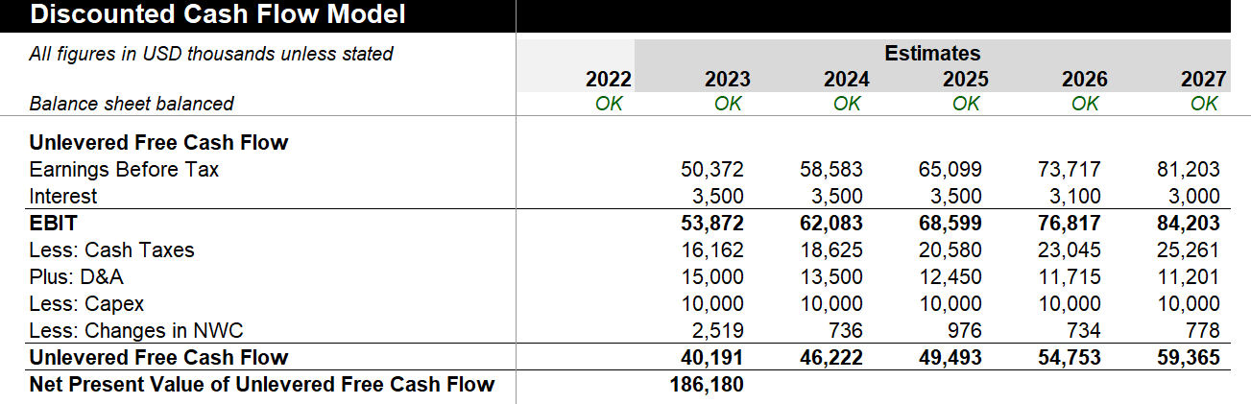
Step 4 - Estimate the Unlevered Free Cash Flow
Ideally all these figures should be pulled from either the income statement or the Balance sheet
Since $1 earned in the future is worth less than $1 earned today, it is important to calculate the Net Present Value of Unlevered Free Cash Flow

Slide 8
Step 5 - Calculate the Net Present Value of Unlevered Free Cash Flow
Since $1 earned in the future is worth less than $1 earned today, it is important to calculate the Net Present Value of Unlevered Free Cash Flow

Slide 9
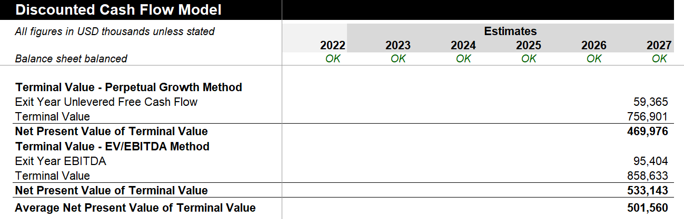
Step 6 - Calculate the Net Present Value of Terminal Value using the Perpetual Growth Method and the EV/EBITDA Method

Slide 10
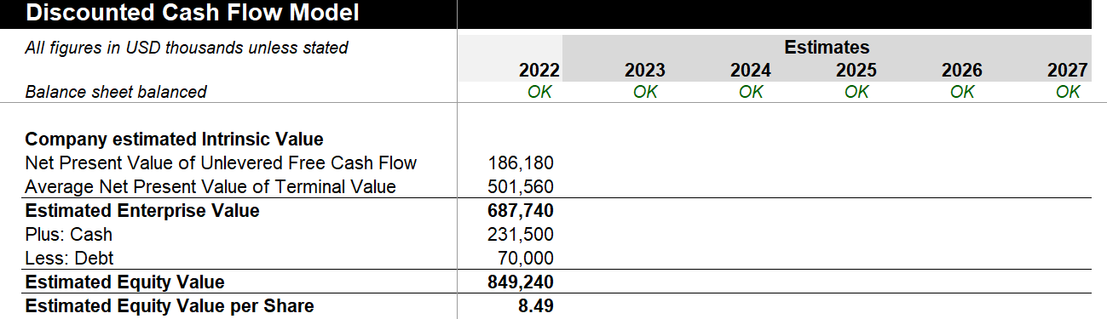
Step 7 - Calculate the Company estimated Intrinsic Value

Slide 11
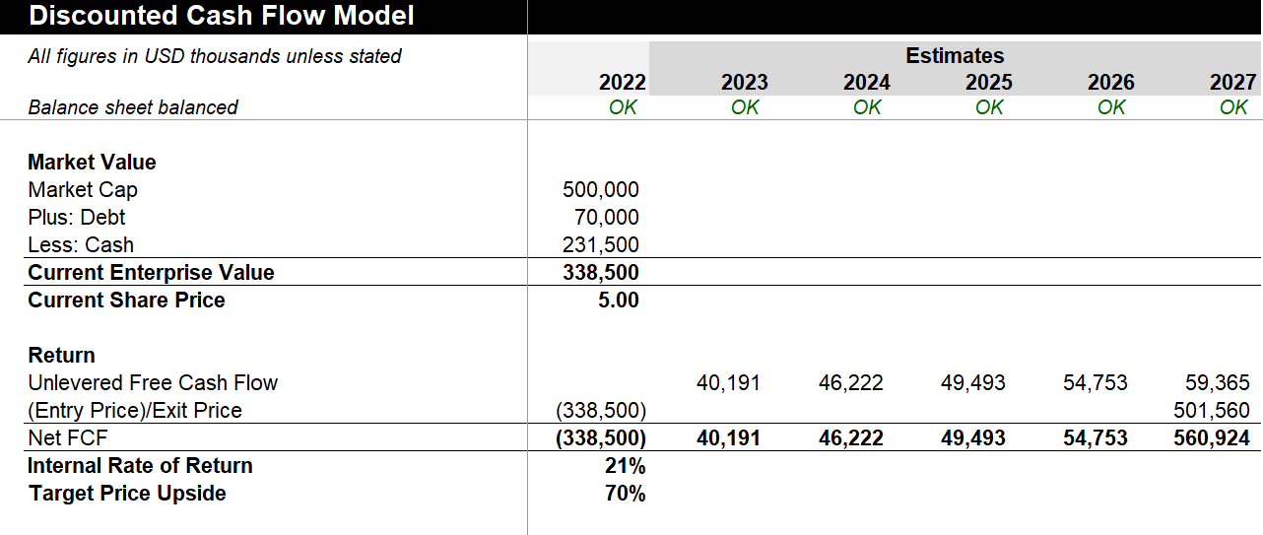
Step 8 - Calculate the current Market Value of the company

Slide 12
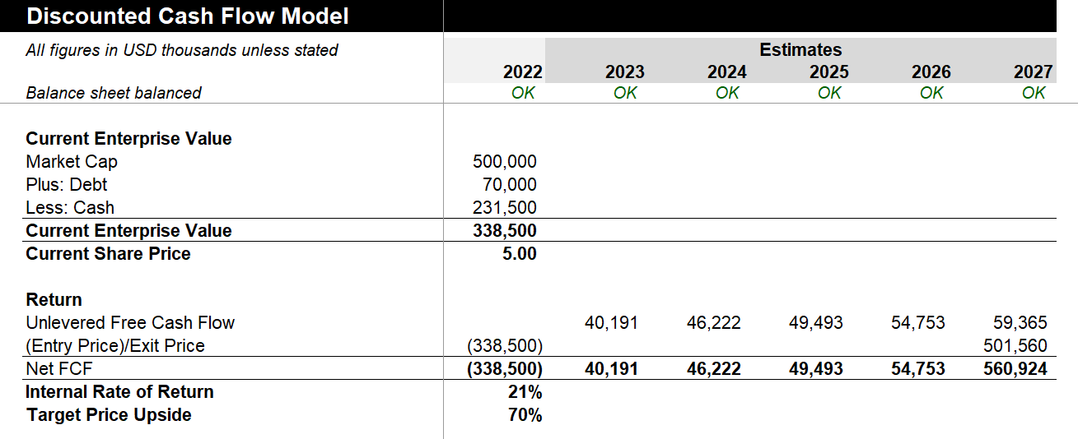
Step 9 - Calculate your Internal Rate of Return based on the company estimated intrinsic value and the Market Value

Slide 13

Interested in more than 1 Toolkit? Access all our Toolkits for half the price with our Gold Access
Gold Access
Click here to learn more

Slide 14

Thanks for your attention!
www.domontconsulting.com

